Slide 1
Analysis of the qualities of human movement in individual performances
A. Camurri, M. Mancini, G. Volpe, F. Odone
project2@enterface.net
Notes:
HI EVERYBODY
THANK YOU TO BE HERE, I’M GOING TO PRESENT PROJECT NUMBER 2
I WOULD LIKE TO THANK MY COLLEAGUE DAMIANO AND KSNEIA
OUR SUPERVISORS ARE FROM UNIVERSITY OF GENOVA:

Slide 2
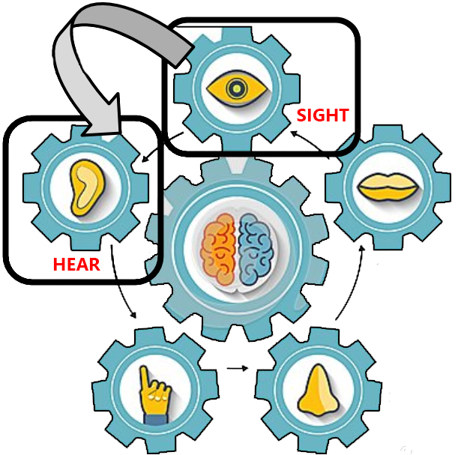
Context
Project objectives
Investigation :
human movements
movements expressive qualities
sensory substitution techniques
Application :
enable blind people to perceive bodily movement
Notes:
LET’’S START FROM THE BEGINNING, THE PROJECT WE WORKED ON THE LAST MONTH IS PART OF A EU PROJECT NAMED DANCE
IT IS ABOUT
INVESTIGATING HUMAN MOV QUALITIES
STUDYING HOW TO COMMUNICATE A QUALITY TO PEOPLE THAT CANNOT SEE

Slide 3
Movement Features Considered
We are considering three different kinds of characteristics of the dynamic of a movement
Is it fluid or rigid?
With how much energy is the subject performing the movement?
Could we spot an impulsive behaviour within the execution of the movement?
Notes:
WHAT ARE THE MOVEMENT QUALITIES WE WANT TO STUDY:
WHAT WE CONSIDERED AS INTERESTING FEATURES ARE:
Fluidity
Quantity of Energy
Impulses in movement

Slide 4
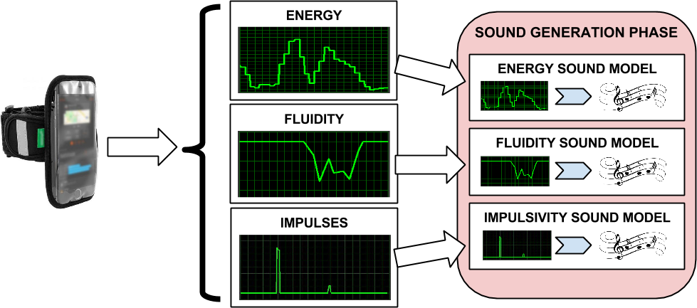
Extraction Techniques (accelerometers)
Starting from the data available from the accelerometers we extract some characteristics of the dynamics of the movements analysed
Notes:
HOW TO EXTRACT THESE INFORMATION FROM HUMAN THAT IS MOVING ? :
FIRST OPTION : SMARTPHONES: so we developed an application to send SENSOR data to our software for analysis
Via OSC communication
NB : really cheap smartphpones

Slide 5
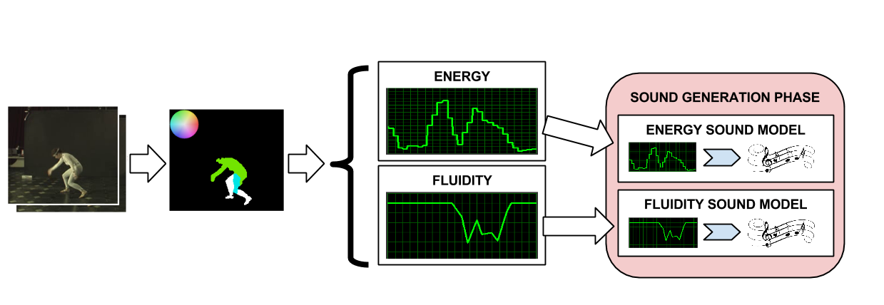
Extraction Techniques (video sequences)
Evaluating the behaviour of the optical flow between each pair of frames of the sequence considered, by analysing the evolution of the resulting histogram of the optical flow
Notes:
SECOND OPTION:
EXPLOIT A WEB CAM TO UNDERSTAND WHAT IS HAPPENING AND HOW THE PERSON MOVE
THROUGH THE OPTICAL FLOW

Slide 6
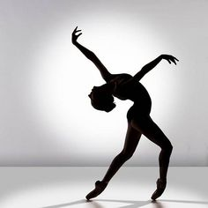
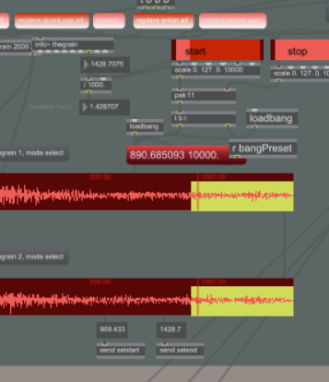
Interactive Sonification
Definition: data exploration by interactively manipulating the data’s transformation into sound
Data from accelerometers, webcam
Transformation
Notes:
NOW LET’S SAY THAT WE WERE ABLE TO EXTRACT AND DETECT
EACH QUALITY
THE NEXT STEP FOR US HAS BEEN TO TRANSLATE THE TYPE OF QUALITY AND COMMUNICATE IT
IN REAL TIME THROUHG ANOTHER SENSORY CHANNEL : SOUND

Slide 7
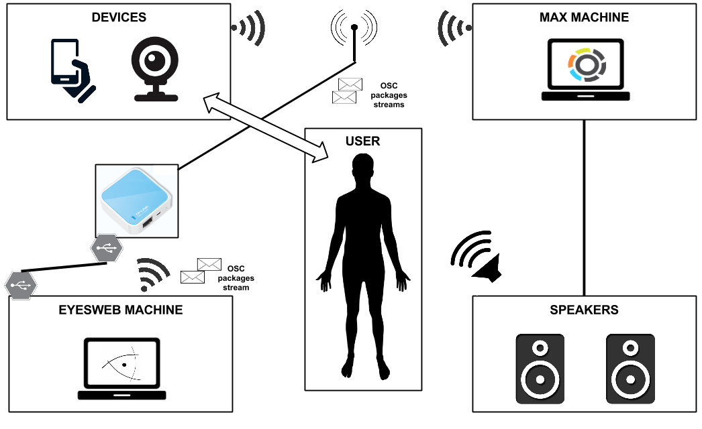
System architecture
Notes:
HERE WE CAN SEE THIS IS WHAT WE

Slide 8
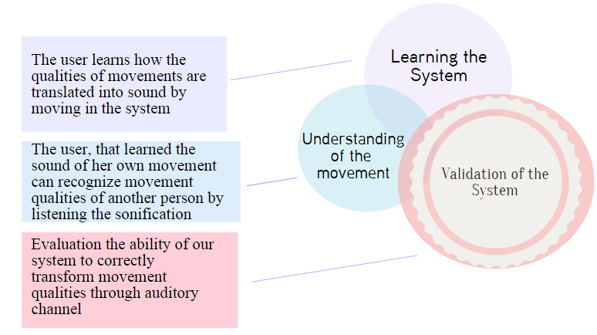
Experiment: Testing and Validation of the System
Investigation of the user’s capabilities and sensibility in recognizing individual movement qualities by means of the auditory modality

Slide 9
Experiment: Testing and Validation of the System
Q1: Is it possible for the user to understand the mapping between his movement qualities (fluid – rigid, low energy – high energy, impulsive movements) and the associated sonifications while exploring the feature space?
Q2: Given a particular movement feature, which is the sound that represents it the most?
Q3 Is it possible for the user to distinguish the proposed movement qualities only through the auditory domain ?

Slide 10
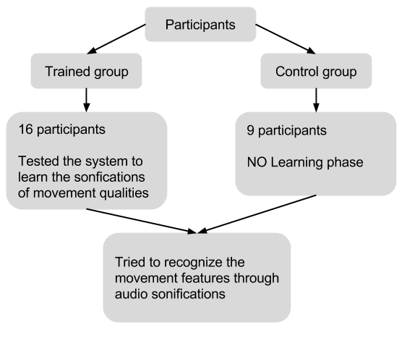
Experiment (I)

Slide 11
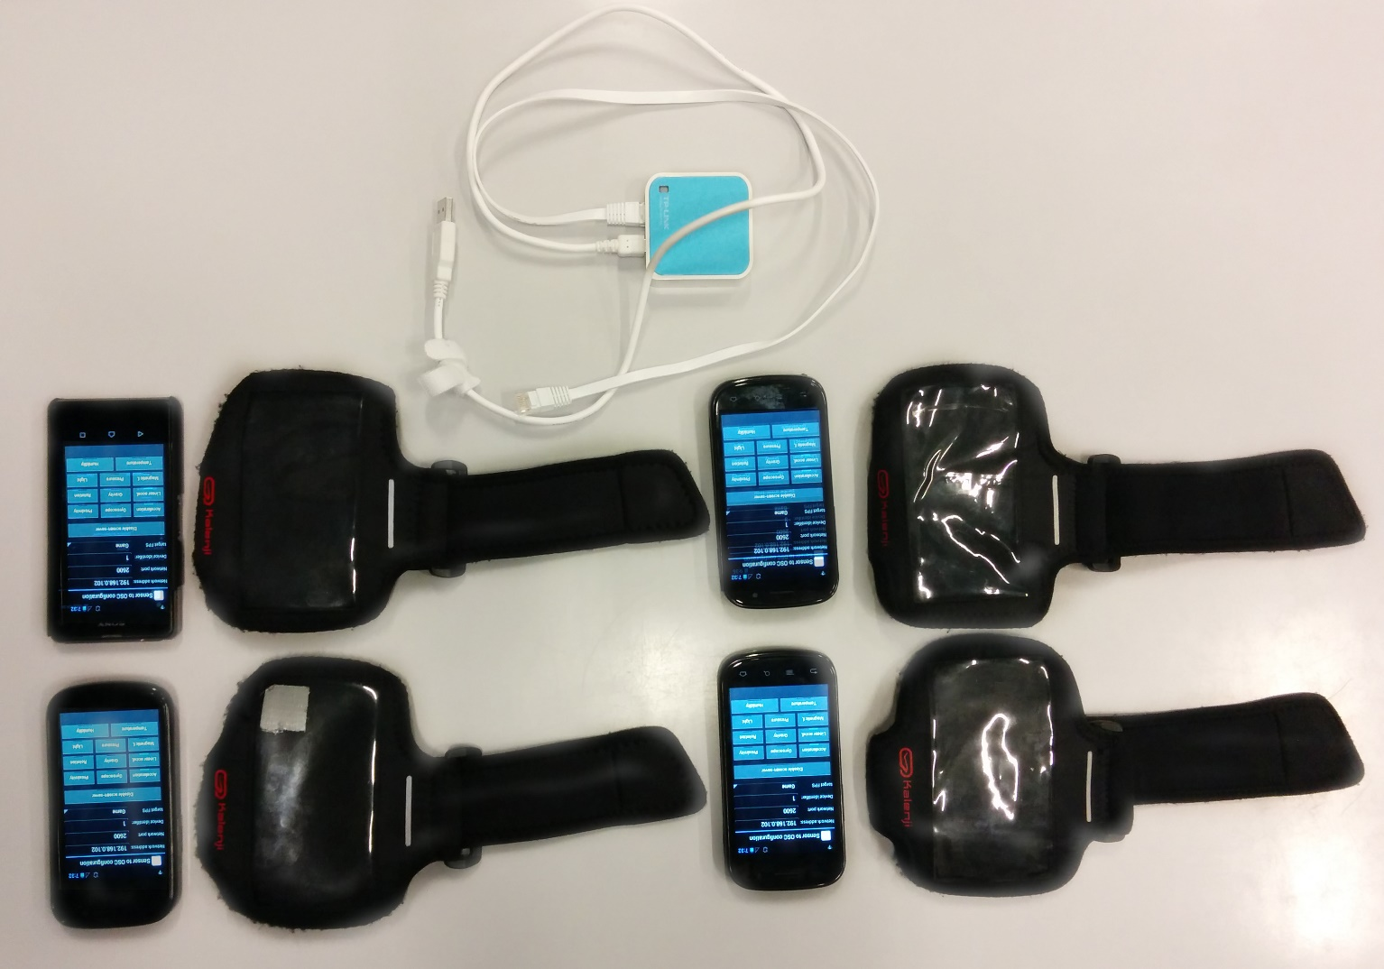
Equipment

Slide 12
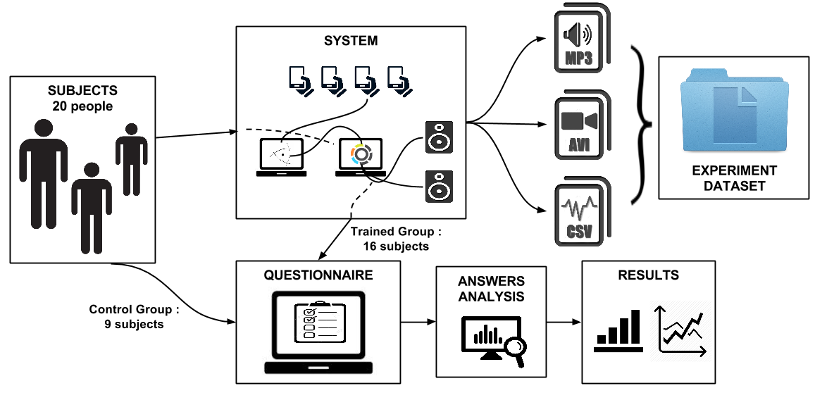
Experiment (II)

Slide 13
Collected Feedbacks
not at all
very much

Slide 14
Collected Feedbacks (II)
Sound
responsive to the movements
easy to manipulate
Learning of the System
interesting
intuitive
not confusing
Features
easy to differentiate between movements features
noticeable difference between using one or more limbs
Equipment
comfortable enough

Slide 15
System Evaluation: Fluid/Rigid – Low/High Energy
Fluid/Rigid movements - Low/High Energy
Low/High Energy Movements
Sounds generated by the system resulted to intuitive for
the users with or without training

Slide 16
System Evaluation: Fluid/Rigid Movements
Sonification of rigid movements with low energy was significantly
better recognized after the training

Slide 17
System Evaluation: Fluid/Rigid Movements
ANOVA
 |  | Sum of Squares | df | Mean Square | F | Sig.
Rigidity Low Energy | Between Groups | .417 | 1 | .417 | 10.015 | .004
 | Within Groups | .958 | 23 | .042
 | Total | 1.375 | 24
Rigidity High Energy | Between Groups | .000 | 1 | .000 | .007 | .933
 | Within Groups | 1.375 | 23 | .060
 | Total | 1.375 | 24
Fluidity Low Energy | Between Groups | .065 | 1 | .065 | 1.659 | .210
 | Within Groups | .895 | 23 | .039
 | Total | .960 | 24
Fluidity High Energy | Between Groups | .010 | 1 | .010 | .131 | .720
 | Within Groups | 1.750 | 23 | .076
 | Total | 1.760 | 24

Slide 18
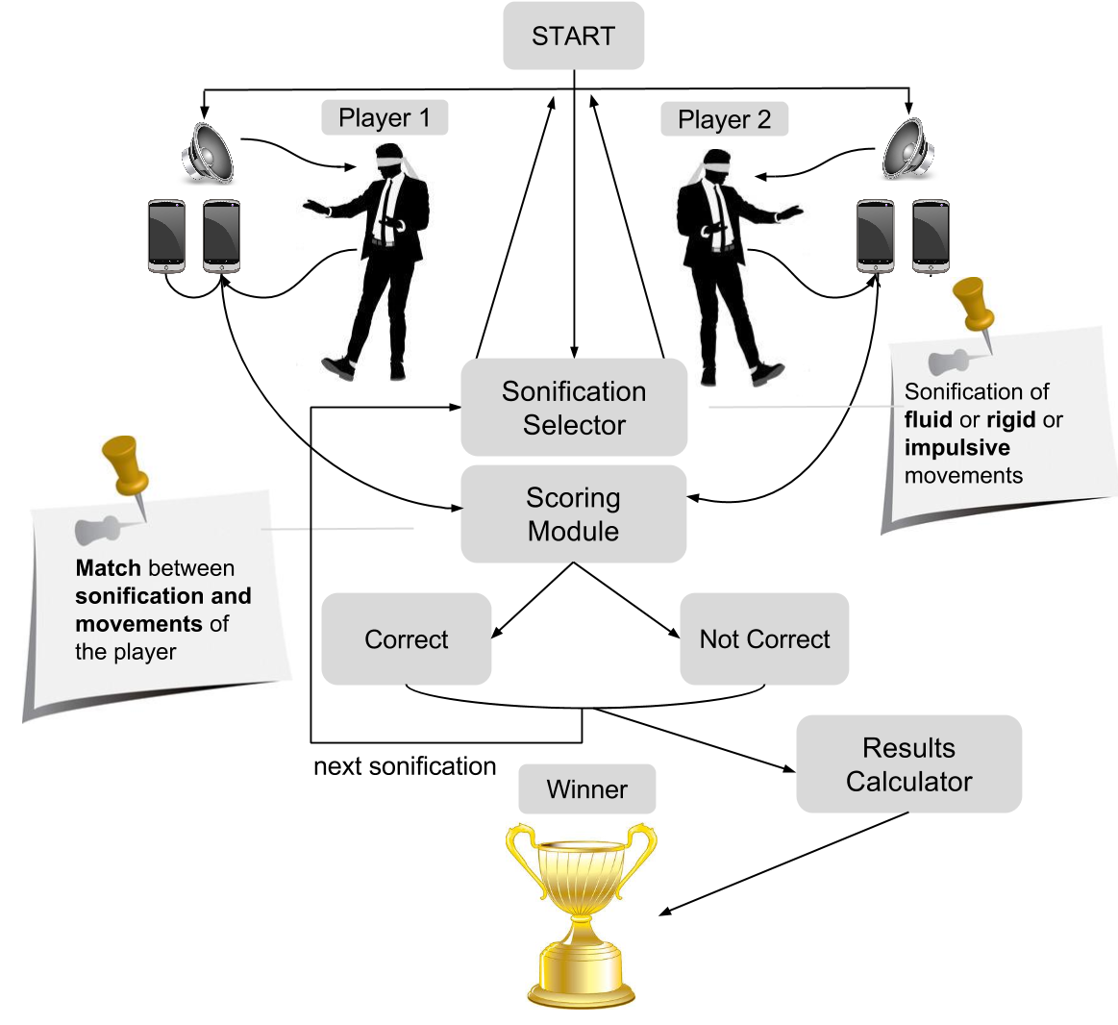
GAME : MOVE IN THE DARK

Slide 19
Conclusions
Q1: Is it possible for the user to understand the mapping between his movement qualities (fluid – rigid, low energy – high energy, impulsive movements) and the associated sonifications while exploring the feature space?
Answer: Yes
Q2: Given a particular movement feature, which is the sound that represents it the most?
Answer: Future Work
Q3 Is it possible for the user to distinguish the proposed movement qualities only through the auditory domain ?
Answer: Yes

Slide 20
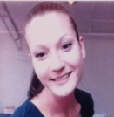
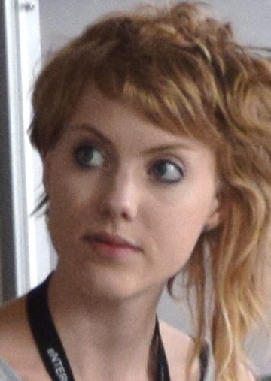
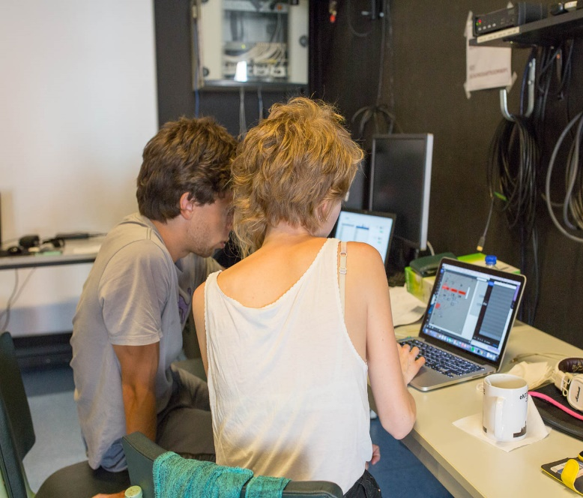
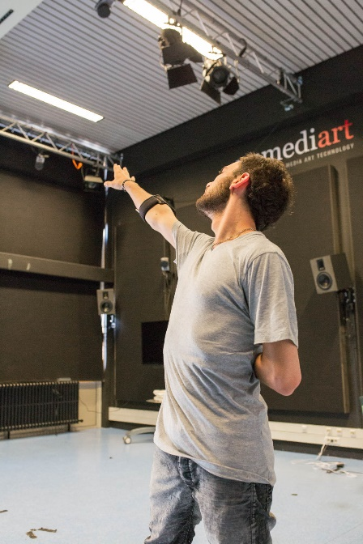
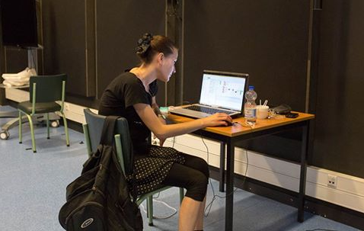
TEAM
UNIGE – CASA PAGANINI - DIBRIS
KTH
MAASTRICHT UNIVERSITY

